Slide 1
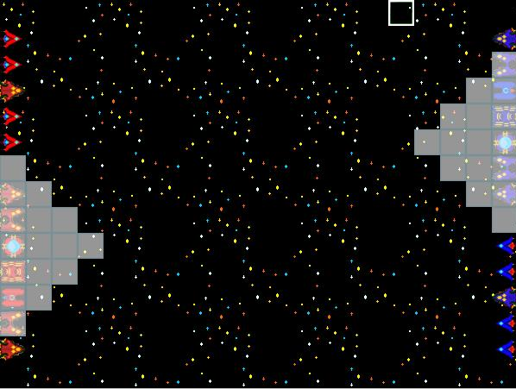
Team Pizza Presents
A Pizza Space Tactics
Team Members:
  Taylor Caldwell
  William Kluegel
  Carl Williams

Slide 2
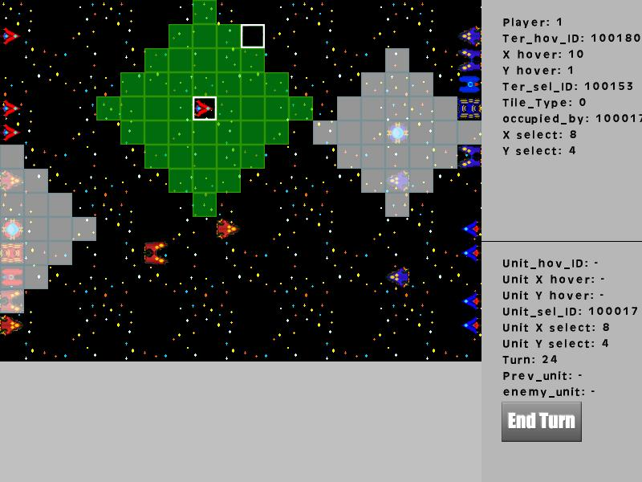
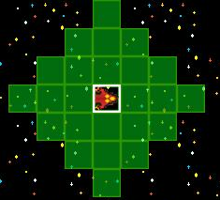
Unit Types(Combat Units)
The Interceptor
  Fast, but very weak.
The Fighter
  Slower than the Interceptor with more fire power!

Slide 3
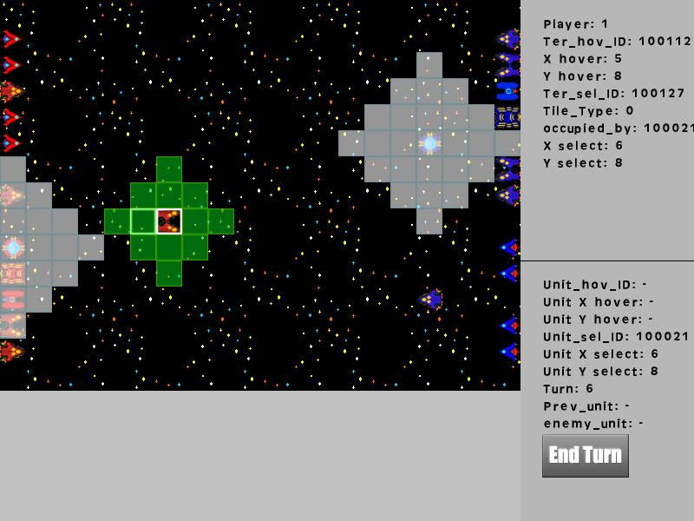
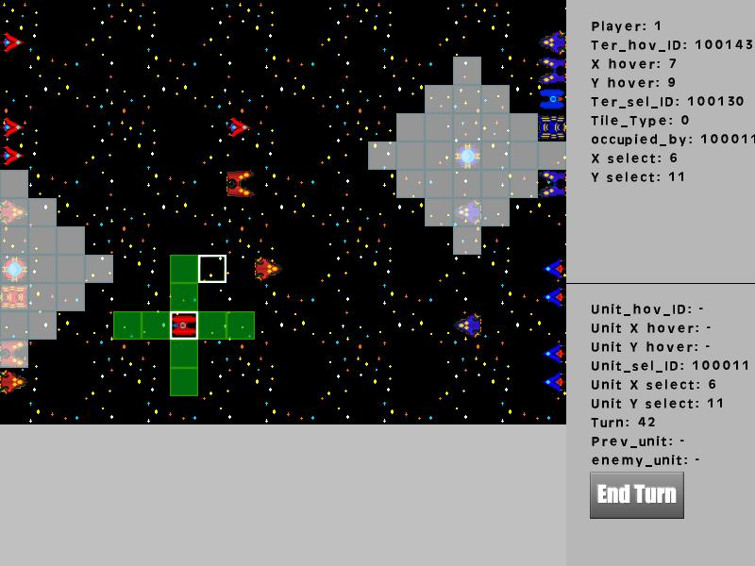
Unit Types(Combat Units)
The Bomber
  Slow, decently armored, and powerful.
The Cruiser
  Slow, not very agile, but heavily armed and armored.

Slide 4
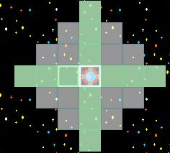
Unit Type(Utility Units)
Shield Generator
  Provides protection for units, preventing mutual destruction of evenly matched units, unless they are both protected.
  Cannot Attack and can be destroyed by any combat unit.

Slide 5
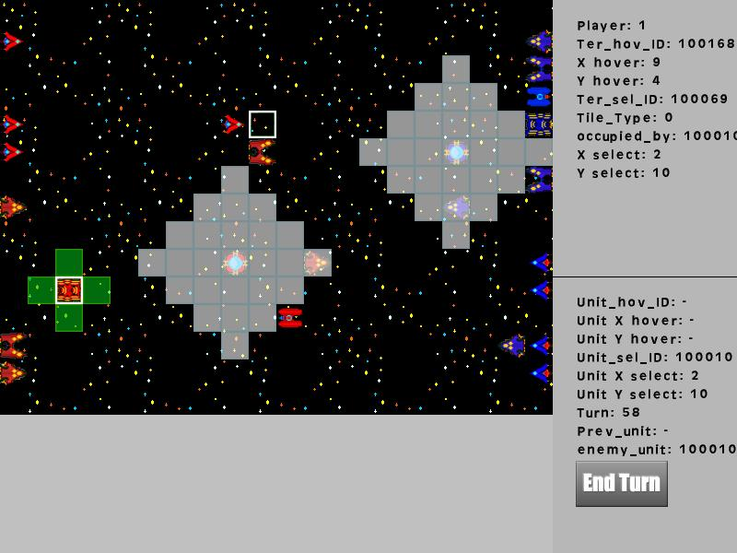
Capital Ship
  Slow but heavily armed and armored.
  If you lose this, you lose!

Slide 6
Combat Balance Chart

Slide 7
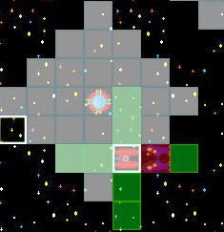
Unit UI
White = Shield Range(team color will be added later
Green = Movement Range
Red = Enemy Unit in movement range
Your own units aren't highlighted.

Slide 8
Hud/Debug Console
The Hud will be used to display a close-up unit portrait as well as visible unit/map information.
The end turn button took quite a bit of time, but works amazingly well now!

Slide 9
Upcoming Features
The ability to create units from capital ships and planets.
Resource generation.
Capturing Planets

Slide 10
Upcoming Features – More Utility Units
Black Hole Generator
  Decreases movement speed of all units within range.
Wall Generator
  Projects an impassible barrier within a certain range in a single direction.
Boost Gates
  Increases movement speed of all units within range.
Weapons Booster
  Increases weapons power of units.

